Slide 1

Trematodes
COLLEGE OF MEDICINE AND HEALTH SCIENCES
SCHOOL OF NURSING AND MIDWIFERY
COURSE: MEDICAL PARASITOLOGY

Slide 2
Trematodes (flukes) – General Characteristics
Trematodes are members of the platyhelminthes
They are generally flat, leaf shaped worms (schistosomes are an exception) without a body cavity
They have two mascular suckers:
  An oral type-the beginning of incomplete digestive system
  A ventral sucker – simply an organ of attachment
Most flukes are hermaphroditic.
Schistosomes are the only exception, they have cylindical bodies like nematodes and separate male and female worms exist.

Slide 3
Trematodes (Flukes)
All trematodes require intermediate hosts for the completion of their life cycles.
The first intermediate hosts are the mollusks (snails).
In these hosts an asexual reproductive cycle occurs
Some flukes require various second intermediate hosts before reaching the final and developing into adult worms.
Eggs produced are operculated, the lid opens to allow the larval form to locate appropriate host snail host.
The schistosome do not have operculum, rather the egg shell splits to liberate the larva

Slide 4
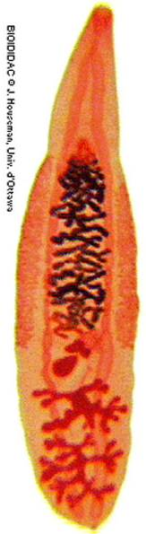
Trematodes
Multicellular eukaryotic helminths
Unsegmented leaf-shaped worms
MONECIOUS except for schistosomes (DIECIOUS)

Slide 5
Trematodes of medical importance
Trematode | Common name | Intermediate host | Biologic vector | Reservior host
Fasciola buski | Giant Intestinal fluke | Snail | Water plans (Water chestnuts) | Pigs, Dogs, humans, rabbits
Fasciola hepatica | Sheep liver fluke | snail | Water plants e.g water cress | Sheep, cattle, humans
Opisthorcis sinensis | Chinese liver fluke | Snail, fresh water fish | Uncooked fish | Dog, cats, humans
Paragonimus westermani | Lung fluke | Snail, fresh water crabs, crayfish | Uncooked crabs, cray fish | Pig, monkeys, humans
Schistosoma species | Blood flukes | Snail | None | Primates, rodents, domestic pets, livestock, humans

Slide 6
Schistosomes
BLOOD FLUKES

Slide 7
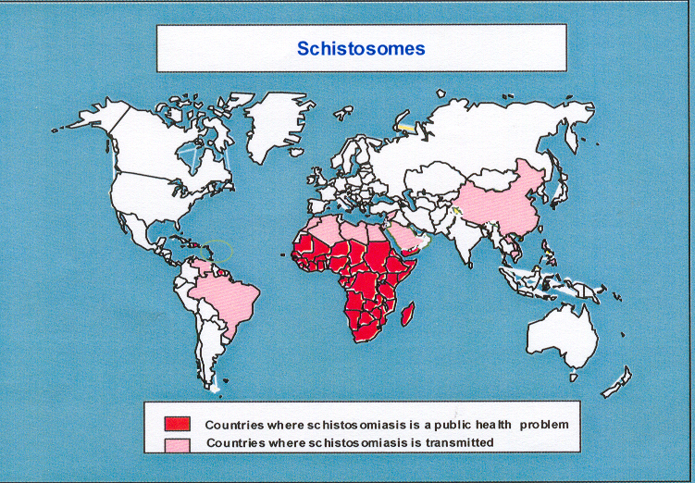
Global Distribution of schistosomiasis
More than 600 million people @ risk of infection
About 207 million people infected
20 million severely affected
200 thousand deaths annually

Slide 8
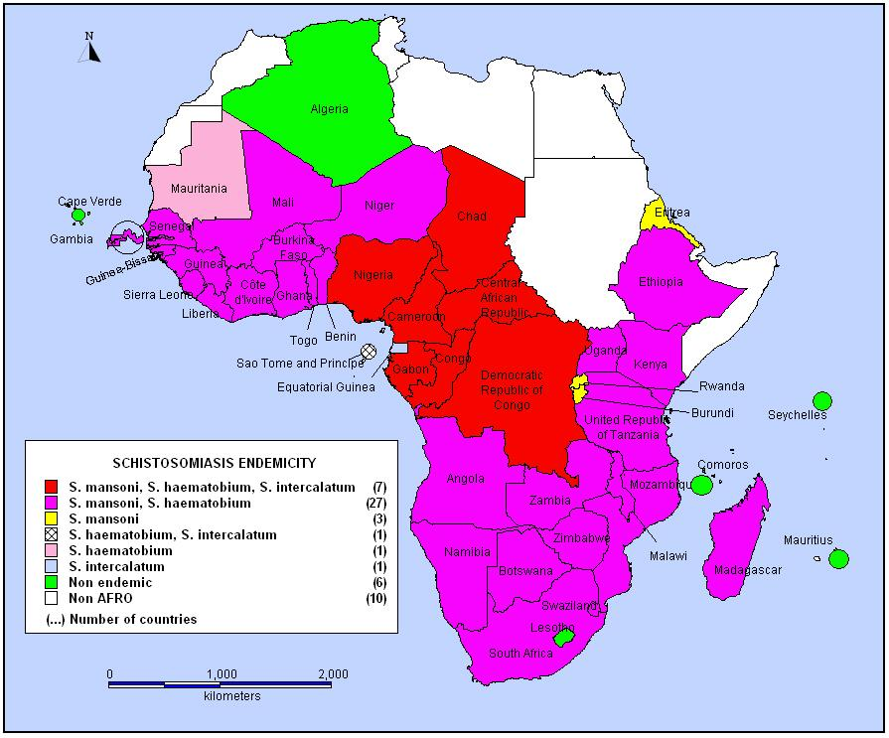
High Burden of Schistosomiasis in the African Region
Almost 90% of SCH burden occurs in Africa
220 million people at risk
42 African countries endemic for SCH, with 40 requiring PC
Various levels of intensities in different countries and communities
Especially in poor communities without adequate sanitation and living around rivers and water bodies
Notes:
NTDs in the African Region also include Guinea worm disease, Dengue and Rabies giving a total of 13 NTDs targeted for control, elimination or eradication by 2020

Slide 9
Characteristics of schistosomes
Of the trematodes, schistosomes are atypical in that the adult stages have two sexes and are located in blood vessels in the definitive host.
The thread like female lies in a ventral longitudinal cleft in the body of the male fluke called the gynaecophoric canal (Friedberg et al., 1991).
S. haematobium adult worms live in the perivesical and other species lives in the mesenteric veins, where they feed on blood particles.
The female produces eggs with a characteristic terminal or lateral spine.

Slide 10
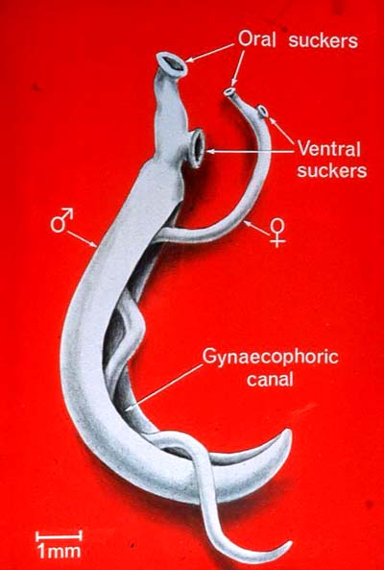
Schistosome worms of medical importance globally
Schistosoma haematobium
S. mansoni
S. intercalatum
S. guineensis
S. japonicum
S. mekongi

Slide 11
Schistosomes infecting humans in Africa
Schistosoma haematobium - causes urogenital schistosomiasis
  Thought to be the most common human schistosome in sub-Saharan Africa
  Widespread throughout the continent, especially along the coastal areas
  Humans the only final hosts
  Bulinus spp are the snail intermediate hosts
  Quite a number of species and not all are compatible with all S. haematobium strains
S. mansoni - causes intestinal schistosomiasis
  Widespread throughout the continent, but only sporadically along the coastal areas
  Biomphalaria spp are the snail intermediate hosts – compatible with all S mansoni strains
  Infects other vertebrates, rodents and other primates
S. guineensis - causes intestinal schistosomiasis
  Found in the tropical rain forest north of Congo.
  Bulinus spp the intermediate hosts
S. intercalatum - causes intestinal schistosomiasis
  found in the tropical rain forest of the Congo with Bulinid spp as vectors
  Both S. guineensis and S. intercalatum hybridize with S. haematobium

Slide 12
Distinguishing various schistosome species
Various schistosome species are distinguished according to:
Their specific snail intermediate hosts
Final location of the adult worms in the definitive host
The clinical presentation and pathogenesis
The shape and size of the eggs they produce:
Their pre-patent period in man
The number of eggs they produce

Slide 13
Distinguishing schistosomes by the number of eggs produced
Schistosome Species
No. of eggs produced
S. japonicum
S. haematobium
S. mansoni,
560 – 2200
66-495
22-303
(Jourdane and Theron, 1987)

Slide 14
Schistosomiasis life cycle
The lifecycle of schistosomes includes two hosts:
A definitive host (e.g. man) where the parasite undergoes sexual reproduction
A single intermediate snail host where asexual reproduction occurs

Slide 15
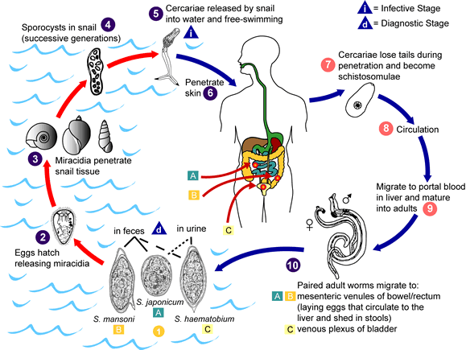
Schistosomiasis life cycle

Slide 16
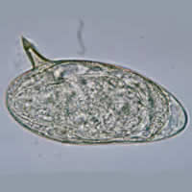
Common schistosome species in Africa
S.mansoni

Slide 17
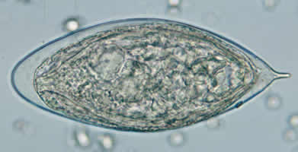
Common schistosome species in Africa
S.haematobium

Slide 18
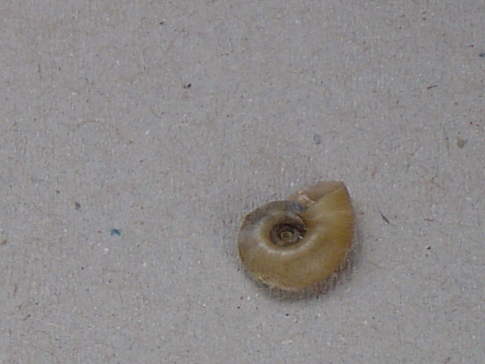
S. mansoni Intermediate host snail
Biomphalaria spp

Slide 19
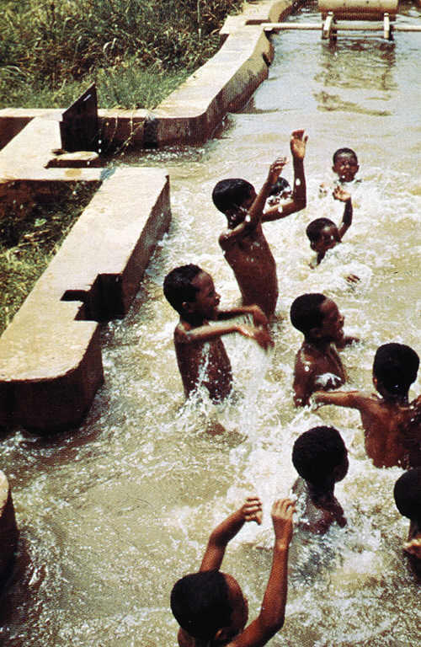
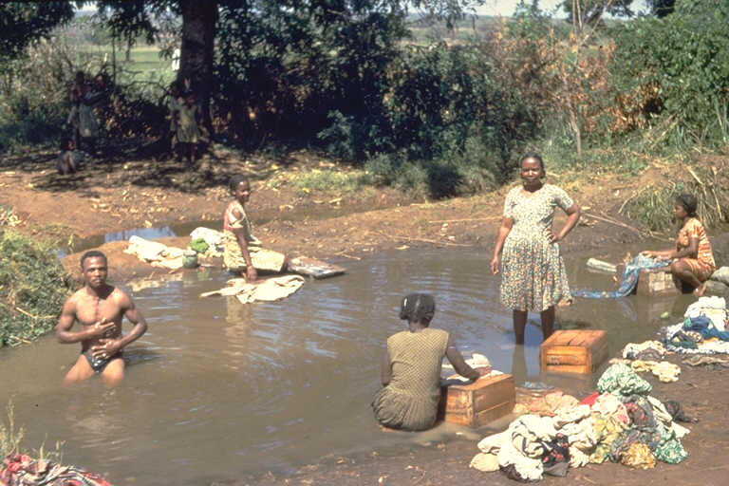
Population at Risk& factors

Slide 20
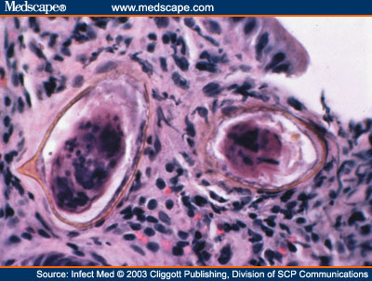
Pathology
Schistosomiasis is typically an immunological disease caused by granulomatous reaction to schistosome egg trapped in the tissues.
This reaction is also referred to as delayed–type hypersensitivity human immune response

Slide 21
Pathology of S. mansoni
The pathology associated with infection with S. mansoni can be divided into two main areas:
  Acute
  Chronic schistosomiasis.

Slide 22
Acute schistosomiasis
Acute Schistosomiasis is also called 'Katayama' fever in areas endemic for S. japonicum (Von Lichtenberg, 1987).
This is associated with the onset of female parasite laying eggs, (approximately 5 weeks after infection) and granuloma formation around eggs trapped in the liver and intestinal wall.
It resembles 'serum sickness' (acute immune complex disease), with hepatosplenomegaly, and leucocytosis with eosinophilia.
This phase of the infection is often asymptomatic, but when symptoms do occur they include fever, nausea, headache, an irritating cough and, in extreme cases diarrhoea accompanied with blood, mucus and necrotic material.
These symptoms, if present, last for 2 to 8 weeks (Friedberg et al., 1991; Von Lichtenberg, 1987).
This condition is not as commonly associated with S. mansoni infections compared with S. japonicum.

Slide 23
Chronic Intestinal schistosomiasis
Chronic intestinal schistosomiasis and the hepatic schistosomiasis manifest a number of years after infection.
The pathogenic reaction is a cellular, granulomatous inflammation around eggs trapped in the tissues, with subsequent fibrosis.
All areas of both the small and large intestine may be involved, with the large intestine showing the most severe lesions, whereas severe pathology in the small intestine is only rarely observed, even though large numbers of eggs may be deposited here.
Colonic polyps are also sometimes seen.

Slide 24
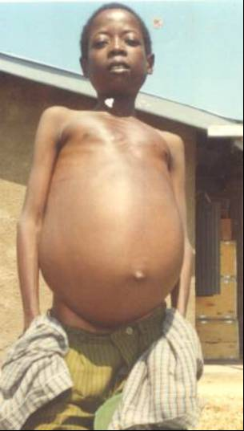
Chronic Intestinal schistosomiasis
Chronic hepatosplenic schistosomiasis is associated with:
  hepatosplenomegaly,
  Portal hypertention associated with blockage of portal venules.
This complication can result in death of the patient.
Abdominal discomfort due to organomegally occurs.
The tough, congested spleens may actively sequester erythrocytes, white cells and platelets giving rise to hypersplenic anaemia

Slide 25
Pathology due to S. haematobium
Pathology caused by S. haematobium like any other species is related to infection intensity.
Adult parasites are found in small venules around the bladder and ureter, with the majority of egg deposition in the tissues of these organs as eggs pass through the bladder wall to leave the body in the urine.
The disease caused is chronic in nature, with the most frequently affected organ being the urinary bladder, where calcification of eggs trapped in the tissues often occurs (Von Lichtenberg, 1987).
The disease is characterised by blood in the urine (haematuria). Cancer of the bladder, hydronephrosis and renal failure are important complications of infection with S. haematobium (Von Lichtenberg, 1987).

Slide 26
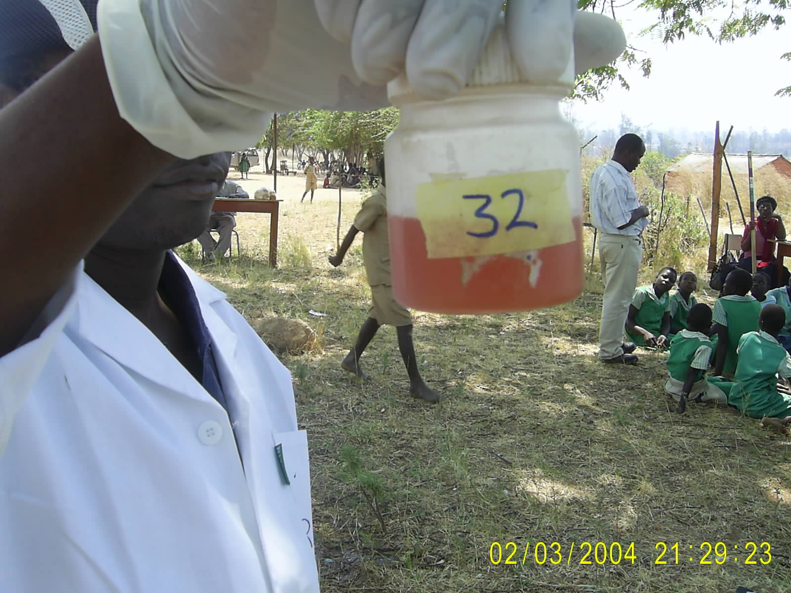
Blood loss and anaemia
Leads to reduced cognitive development in primary school children

Slide 27
Other important problems associated with bilharzia infection
It impairs cognitive development in children causing poor educational performance
Affected children are weak all the time and may fail to participate actively in carrying out assigned domestic chores
They will fail to participate in sports at school
Affected children may suffer from anemia due to excessive loss of blood
Affected children’s growth is impaired (stunted)

Slide 28
Diagnosis
Formal ether concentration technique, Kato Katz for intestinal schistosomiasis
Urine Filtration Technique and microhaematuria analysis for S. haematobium
Circulating Cathodic Antigen of -Care test: Rapid schistosomiasis diagnostic technique for S. mansoni

Slide 29
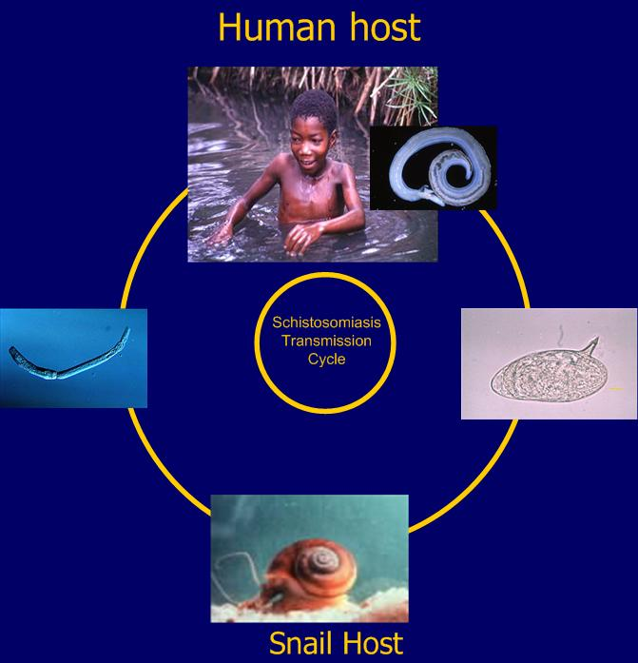
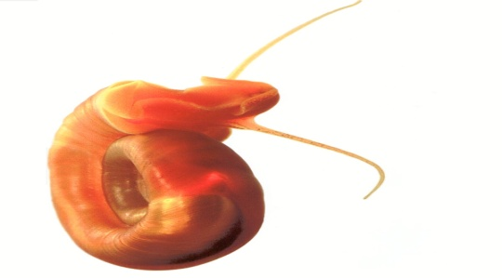
General options for schistosomiasis control
Treatment using Praziquantel
Prevent
water contact
Clean Water
and Sanitation
Snail control
-chemicals
-environmental

Slide 30
Fasciola buski
Intestinal trematodes

Slide 31
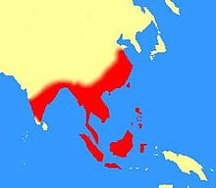
Epidemiology of F. buski
Endemic in Asia:
10 M human infection in East Asia:
China
South East Asia
Taiwan
Indonesia
Malaysia
India (60%)
Central Thailand
Pigs and dogs serve as reservoir hosts in these endemic areas

Slide 32
F. buski
The largest fluke that infects humans
Also known as the giant intestinal fluke
It has a typical life cycle
Human ingest the encysted larval stage (metacercaria) when they peel the husks from aquatic vegetation (water chestnuts) with the teeth.
Metacercariae are scraped from the husk, swallowed and develop into immature flukes in the duodenum.

Slide 33
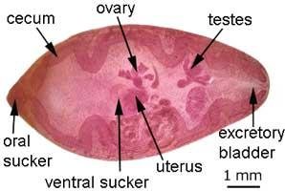
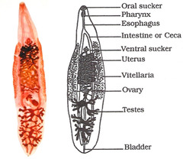
Fasciolopsis buski

Slide 34
F. buski
The flukes attach to the mucosa of the small intestine with two muscular suckers
They develop into adult form and undergo self fertilization
Egg production is initiated 3 months after infection with the metacercariae
The operculated eggs pass in feaces to water.
In water the operculum at the top of the egg shell pops open liberating a free swimming larval stage (miracidium)

Slide 35
F. buski
Miracidia produce lytic substances that allow penetration of the soft tissues of snails.
In the snail tissue the miracidia develops through a series of stages by asexual germ cell propagation
The final stage cercariae in the snail is a free swimming form that after release from the snail, encysts on the aquatic vegetation becoming metacercariae or infective stage.

Slide 36
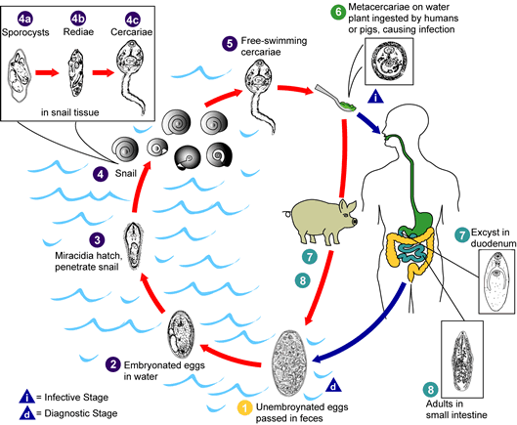
Life cycle (biology) of F. buski

Slide 37
Clinical syndromes
The symptoms are related to worm burden in small intestines.
Attachment of the flukes to the small intestines may produce inflammation , ulceration and haemorrhage.
Severe infection produce abdominal discomfort similar to that of duodenal ulcer and causes diarrhoea
Malabsorption syndrome similar to giardia is common
Intestinal obstruction can occur
Death rarely occur

Slide 38
Diagnosis
Identifying of Fasciola buski eggs in stool under the microscope
Stool examination reveals the large, golden, bile-stained eggs with an operculum on the top
But it is difficult to distinguish eggs of F. buski from those of F. hepatica using microscopy.
The eggs from the two species are very similar.
Rarely adult flukes are found in the stool

Slide 39
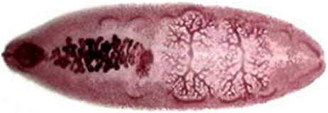
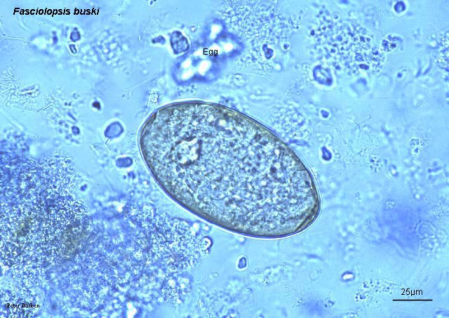
F. buski
Adult F. buski, about 20-75 mm long and 8-20mm wide
Flat, leaf shaped, blunt anterior end, poorly developed oral and ventral suckers
Ova is thin shelled, operculated, microscopic, measuring about 130-160µm long and 70-90 wide

Slide 40
Treatment
Praziquantel
alternative -Niclosamide

Slide 41
Prevention of Fasciolopsis
Avoid use of human and pig faeces as fertilizer
Education regarding the safe consumption of infective aquatic vegetation
Proper sanitation
Mollusciciding to control snails
Treatment of infected individuals to minimize spread of the disease
Control of reservoir hosts

Slide 42
Fasciola haepatica
Liver fluke

Slide 43
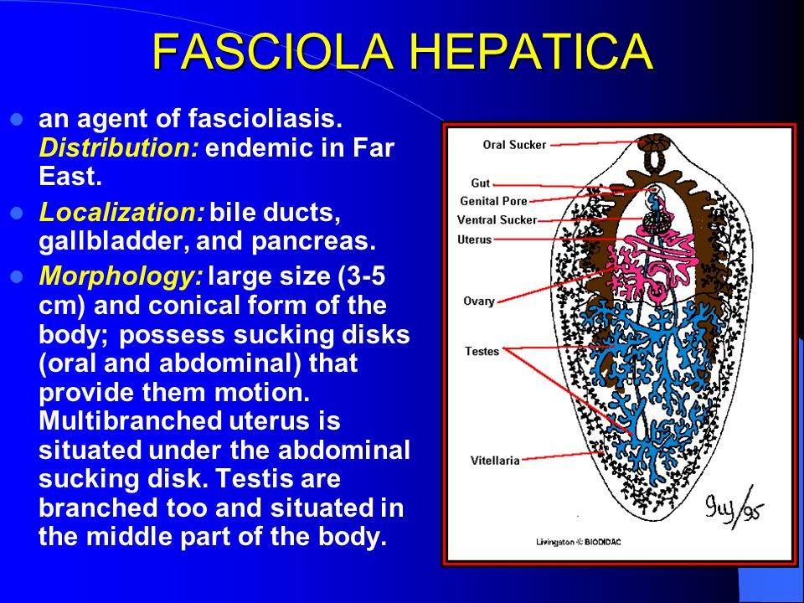

Slide 44
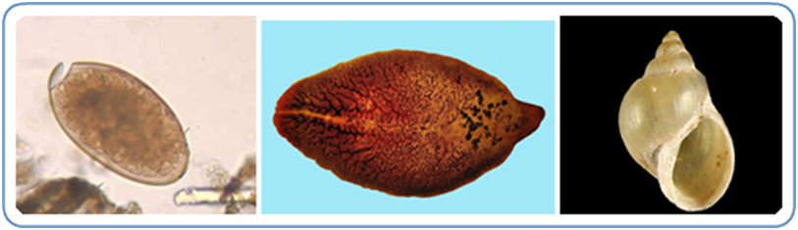
Fasciola hepatica
Left: F. hepatica egg; Centre: F. Hepatica: Right: Intermediate host-Fossaria bulamoides in the western United States

Slide 45
Epidemiology and Risk Factors
Fasciolosis is caused by F. hepatica (a common liver fluke of sheep and cattle) and humans
Wide spread in animals than humans
2 Million people infected world wide

Slide 46
Epidemiology
Occurs in:
Latin America
The Caribbean
Europe
Middle East
Africa
Outbreaks are directly related to human consumption of contaminated watercress in areas where infected herbivores are present

Slide 47
Transmission
Infective larvae (metacercariae) are found in water
They are either stuck (encysted) in water plans or floating in water
Often in marshy areas, ponds or flooded rivers
People and animals become infected by eating watercress or other contaminated water plans
Plants may be eaten as snacks or salads
Infection can also be through eating undercooked sheep/goat livers that contain immature parasite

Slide 48
Transmission
Life cycle similar to that of F. buski
Human infection results from the ingestion of watercress that harbors the encysted metacercariae.
The larval flukes migrate through the duodenal wall and across the peritoneal cavity
They penetrate the liver capsule, pass through the parenchyma and enter the bile ducts to become adult worms

Slide 49
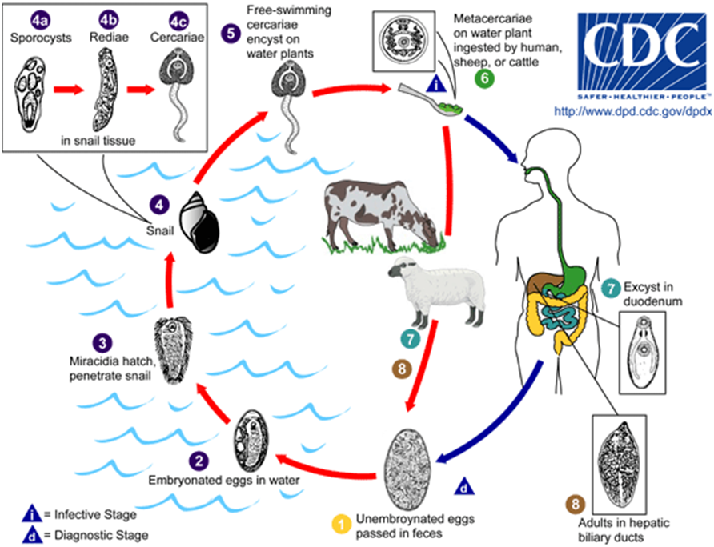
Fasciola hepatica Life cycle
Maturation to adult flukes
takes 3-4 months in human
Development in Snail is
completed in 5-7 wks

Slide 50
Clinical syndromes
Fascioliasis is an infection of the bile duct and liver.
Acute phase (migration from intestines to the bile duct)
Tissue destruction due to larval migration
Local or systemic allergic reactions
Internal bleeding
Anaemia esp. in children
Fever
eosinophilia
Symptoms of chronic infection (when parasite settles in the duct, lays eggs that are passed in stool)
Inflammation and blockage of the bile duct
Inflammation of the liver
Liver cirrhosis
Inflammation of the pancreas

Slide 51
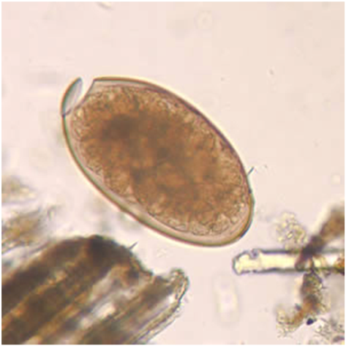
Diagnosis
Microscopy:
By finding F. hepatica eggs in:
Stool
Duodenal contents
Bile
More than one specimen should be examined
Serological test:
ELISA techniques
F. haepatica egg in unstained wet mount: Ellipsoidal, operculated, 130-150 by 60-90 µm

Slide 52
Treatment
Triclabendazole
Praziquantel is not effective
Prevention
Treatment of infected individuals to reduce transmission
Control of the growth and sale of watercress and other edible water plants

Slide 53
Paragonimus Westermani
Lung fluke

Slide 54
Transmission
Human get infected with the disease by eating:
  Raw crabs
  And raw fish that are carrying the parasites
In Asia about 80 % of freshwater crabs are infected with the lung fluke.

Slide 55
Other animals that can harbour P. westermani
Dogs
Pigs
Cats
Infection can persist for 20 years in humans

Slide 56
Epidemiology
Paragonimus Westermani infects 22 M people world wide.
Endemic in:
Africa
Asia
South and Central America
South East Asia is particularly affected because raw sea food is very popular there.

Slide 57
Life cycle
Adult female lays eggs
Eggs are carried out from the human lungs in the sputum by the motion of microvilli
Then the eggs are taken through the GIT out of the body
If feaces get in contact with water, after 2 weeks larvae called miracidia hatch
A miracidium locates the intermediate host snail and penetrates its skin.
In 3-5 months miracidium develops into a cercariae

Slide 58
Life cycle
The cercaria crawls out of the snail to find fresh water crayfish or crabs.
It penetrates the muscles of the crab and forms a cyst.
Within 2 months it transforms into metacercaria which is the resting form of the cercaria.
If a human eats the infected crab raw, the metacercaria cyst gets into the stomach.

Slide 59
Life cycle
Once inside the duodenum, the metacercariae excysts
It penetrates the small intestines and moves through the abdominal wall and diaphragm to the lungs
In the lungs the worm develops into an adult
Male and female worms reproduce and the cycle starts again.

Slide 60
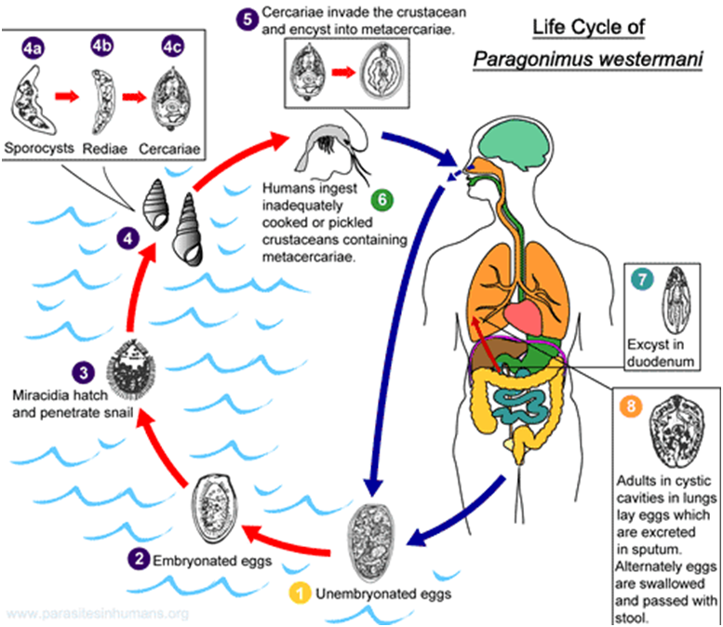
Life cycle of Paragonimus Westermani
Eggs produced
in
sputum
Alternatively eggs are
passed with
stool when swallowed

Slide 61
Disease
Lung flukes cause pain and cough
Abdominal pains
Fever
Hepatosplenomegally
If the fluke worm migrate to the spinal cord instead of the lungs, the host may become paralysed
Infection of the heart, the host may die

Slide 62
Diagnosis
Looking for Paragonimus eggs in sputum
Stool can be examined too but eggs are not present until after 2-3 months of infection
Concentration technique is recommended in light infections
X-ray and biopsies can be taken

Slide 63
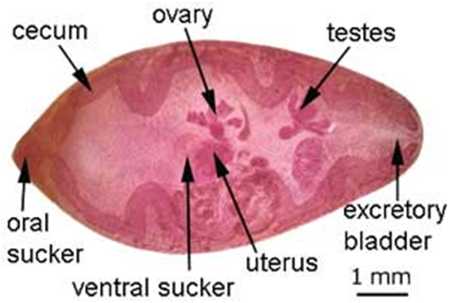
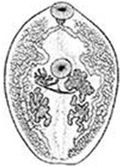
Adult Paragonimus Westermani
They hold to the
host with
two suckers
Adult P. Westermani are red –brown in appearance
7-12mm long and 4-6mm wide

Slide 64
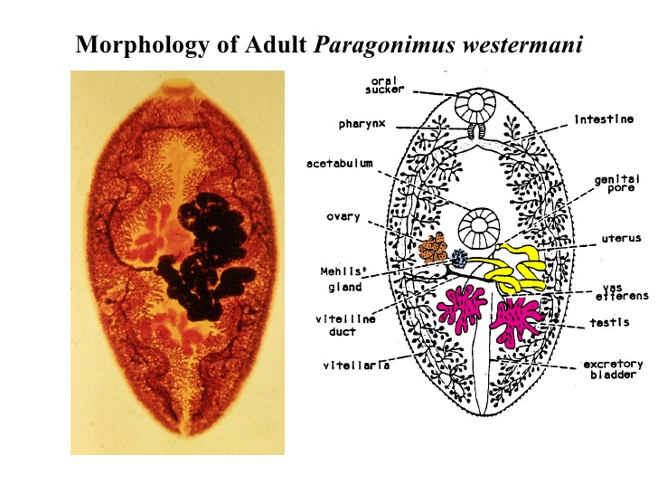

Slide 65
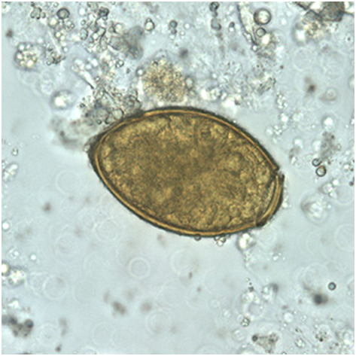
Paragonimus Westermani egg
P. Westermani egg in unstained wet mount
80-120 µm long by 45-70 µm lwide

Slide 66
Treatment
Usually treated with praziquantel
Prevention
The parasite is killed by:
Cooking food
Freezing food

Slide 67
Summary
Fluke | Transmission | Symptoms | Diagnosis | Rx
S. Mansoni; S. japonicum | Skin penetration by cercaria | Abdominal pain, dematitis; ascites; hepatospleenomegaly | Eggs in stool | PZQ
S. haematobium | Skin penetration by cercaria | Bladder cancer, Urethritis, | Eggs in urine | PZQ
Fasciolopsis buski F. hepatica | Metacercaria on water chestnut Metacercaria on watercress | Epigastric pain, ascites, nausia biliary obstruction Cirrhosis, fever | Eggs in stool Eggs in stool, Biliary aspirate | PZQ Triclabendazole
C. Sinensis O. veverini | Cysts in fish | Inflammation and deformation of bile duct, hepatitis | Eggs in stool | PZQ
Paragonimus westermani | Cysts in crab meat | Cough, pulmonary pain, dry sputum | Eggs in sputum | PZQ

Slide 68
The end

