Slide 1


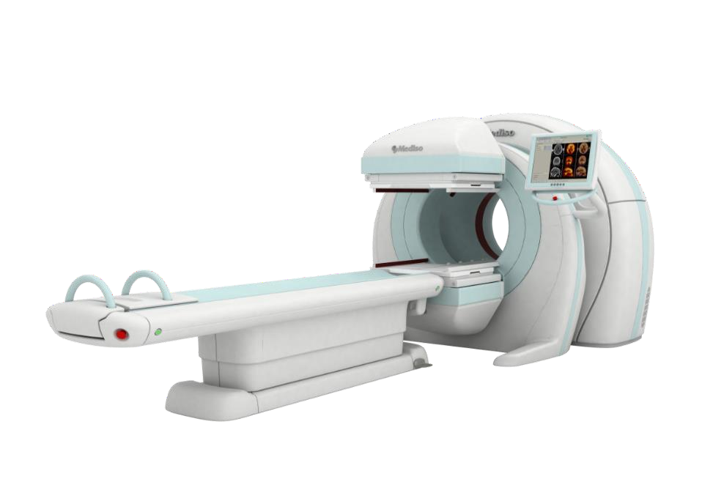
IAEA
RADIONUCLIDE PRODUCTION AND RADIOPHARMACY
BANA R.

Slide 2
CONTENTS
Basic concepts on Radiopharmacy
Radionuclide production: Generators, cyclotrons and reactors
Labeling and QC of radiopharmaceuticals
Adapted from: Nuclear Medicine Physics: A Handbook for Teachers and Students

Slide 3


RADIOPHARMACY: BASIC CONCEPTS
Radiopharmaceutical = Pharmaceutical + Radionuclide
Pharmaceutical: Defines the metabolic characteristics of the compound
Radionuclide: It is the traceable part, the label of the compound
Carrier
Radionuclide
Radiopharmaceutical
Examples: 111In-Dotatoc 99mTc-MIBI
90Y-Ibritumomab
188Re-HR3
131I-MIBG FDG
99mTc
DTPA
99mTc-DTPA

Slide 4
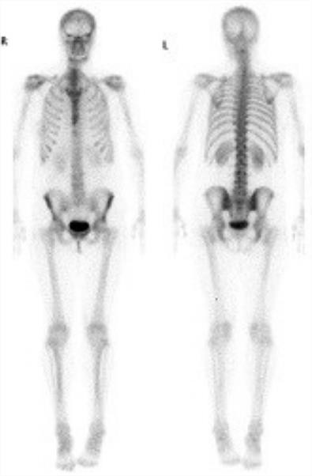
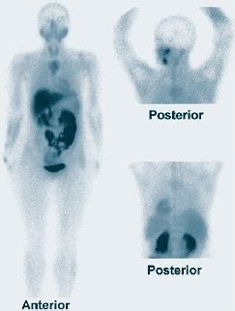
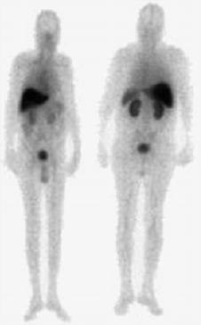
RADIOPHARMACY: BASIC CONCEPTS
SAME RADIONUCLIDE DIFFERENT UPTAKE→ CARRIER DEFINES THE RADIOPHARMACEUTICASL PK & BIODISTRIBUTION
99mTc-MDP | 99mTc-DMSA | 99mTc- Nimotuzumab

Slide 5
BASIC CONCEPTS
Compound | Carrier | Clinical Use
99mTc-MDP | Methylene diphosphonate | Bone scans
99mTc-DMSA | 2,3-Dimercaptosuccinic acid | Renal imaging
99mTc-DTPA | Diethylenetriaminepenta acetic acid | Renal function
99mTc-sestamibi | 2-Methoxy-2-methylpropyl isonitrile | Myocardial perfusion,
99mTc-HMPAO | Hexamethylpropylene-amine oxime | Cerebral perfusion
99mTc-HIDA | N-(2,6-dimethylphenol- | Hepatic function
 | carbamoylmethyl)-iminodiacetic acid
99mTc-ECD | N,N’-1,2-ethylenediyl-bis-L-cysteine diethylester | Cerebral perfusion

Slide 6
RADIOPHARMACY: BASIC CONCEPTS
Desired Attributes of Radiopharmaceuticals for NM imaging
Radionuclide decay should result in gamma emissions of suitable energy (100-200 keV is ideal
for gamma cameras and about 511 keV for positron emission tomography [PET])
High percent likelihood of emissions per decay
Should not contain particulate radiation (e.g., beta emissions)
The effective half-life should be long enough for only the intended application usually a few hours
Should be carrier-free (not contaminated by either stable radionuclides or other radionuclides of the same element)
high specific activity—that is, radioactivity per unit weight
(Technetium-99m most closely matches these desirable features for the gamma camera and fluorine-18 for PET)
Radiopharmaceuticals for therapy also have desired attributes

Slide 7

USE OF RADIONUCLIDES IN NUCLEAR MEDICINE
EMISSION
CLINICAL USAGE
Single Gamma emitters
Beta emitters
Alpha emitter
Auger electron
Positron emission
Combined emissions
Planar scintigraphy, SPECT, RIA (E.G. 99mTc)
Radionuclide therapy (E.G. 90y)
Radionuclide therapy (213Bi, 223Ra)
Radionuclide therapy (e.g. 111In)
Diagnosis (e.g. 68Ga)
Theranostic (e.g. 177Lu)
Diagnosis (e.g. 131I)
RADIONUCLIDES

Slide 8

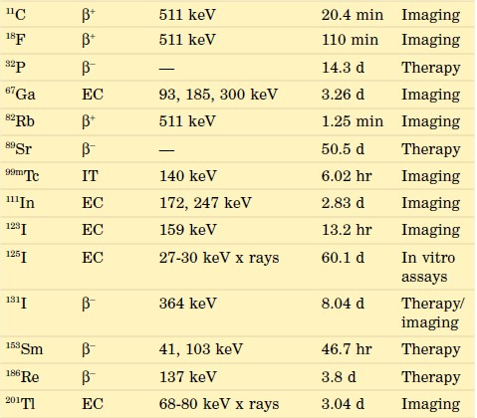
USE OF RADIONUCLIDES IN NUCLEAR MEDICINE
Decay Mode
Principal photon emissions
RN
Half-Life ^{Primary}
use
Physical properties of radionuclides define their clinical usefulness and safety

Slide 9
PRODUCTION OF RADIONUCLIDES
There are three major ways to obtain radionuclides medicine procedures
for nuclear
NUCLEAR REACTOR
CYCLOTRON
GENERATORS
The naturally occurring radionuclides are very long-lived, represent very heavy elements (e.g.,
uranium) that are unimportant in metabolic or physiologic processes, or both.

Slide 10
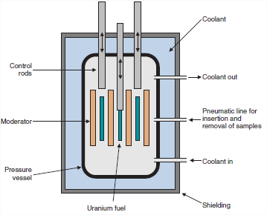
PRODUCTION OF RADIONUCLIDES NUCLEAR REACTORS
Nuclear reactors have for many years provided large quantities of radionuclides for nuclear medicine
It is a facility in which a fissile atomic nucleus (235 U, 239 Pu or 241Pu) undergoes fission after irradiation with low energy neutrons (self- sustaining nuclear chain reaction)
(cadmium or Boron)
(graphite)
Schematic representation of a nuclear reactor.
(Cherry, Sorenson and Phelps)

Slide 11
RADIONUCLIDES FROM NUCLEAR REACTOR
Fission Fragments
The fission process lead to more than 100 nuclides among the fission products. It include medically important radionuclides such as 99Mo:
²³⁵U(n,f)⁹⁹Mo
The half-life of 99Mo is 65.9 hours, which is sufficiently long to allow it to be chemically separated from other fission fragments.

Slide 12
RADIONUCLIDES FROM NUCLEAR REACTOR
Fission Fragments
The fission process in the nuclear reactor also allow to obtain 131I and 133Xe, which are useful radionuclides for nuclear medicine studies.
However, 131I is not carrier-free → high-specific activity 131I cannot be produced on this way because of significant contamination from 127I and 129I

Slide 13
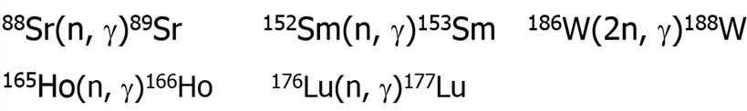

RADIONUCLIDES FROM NUCLEAR REACTOR
Neutron Activation
The intense neutron fluxes obtained in a nuclear reactor are used to create new radionuclides by (n,γ) and (n,p) reactions
This reactions (n,γ) are induced by thermal neutrons and it is the most common production
mode. However their products are not carrier free. Some examples are:
Activating ashort-lived intermediate product as 131Te is possible to obtain carrier free 131I,

Slide 14
RADIONUCLIDES FROM NUCLEAR REACTOR
Neutron Activation
The (n,p) reactions are carried out with high energy neutrons. It allows to produce
carrier-free products in a reactor.
Examples:
³²S (n,p) ³²P
¹⁴N (n,p) ¹⁴C

Slide 15
MAJOR WAYS OF RADIONUCLIDE PRODUCTION
Production device | Beam particles | Radionuclide produced
reactors | neutrons | neutron-rich
accelerators | protons deuterons α particles heavy ions | neutron-deficient
Adapted from: Nuclear Medicine Physics:
A Handbook for Teachers and Students

Slide 16
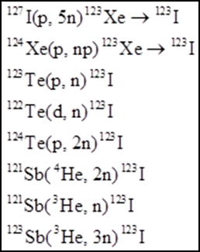
CHARGED PARTICLES REACTIONS
Charged particles need to be accelerated to overcome the Coulomb barrier.
Their kinetic energy makes it possible to open more reaction channels than fast neutrons in a reactor.
Different reactions with charged particles that produce ¹²³I
Adapted from: Nuclear Medicine Physics:
A Handbook for Teachers and Students

Slide 17
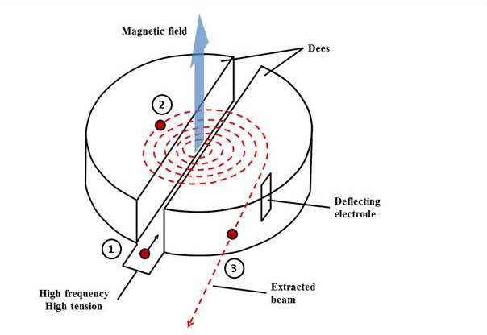
THE CYCLOTRON PRINCIPLE
A ion is injected into the gap between ‘dee’
shaped magnets (1).
An alternating electric field is applied across the gap, which causes the charged particle to accelerate.
The magnetic force on a moving charge forces it to bend into a semicircular path of ever increasing radius (2).
The applied electric field is reversed in direction each time the charged particle reaches the gap, so that it is continuously accelerated, until finally being ejected (3).
Adapted from: Nuclear Medicine Physics:
A Handbook for Teachers and Students

Slide 18
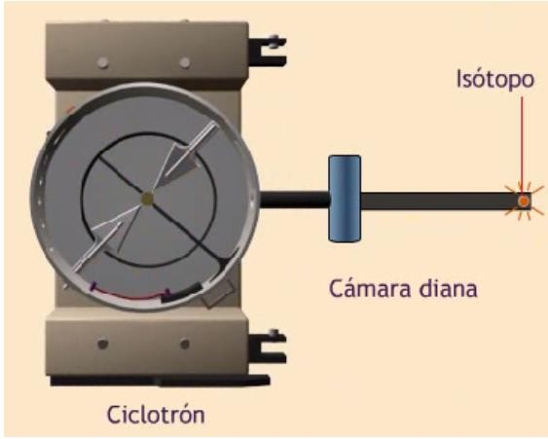

THE CYCLOTRON PRINCIPLE
A ion is injected into the gap between ‘dee’
shaped magnets (1).
An alternating electric field is applied across the gap, which causes the charge to accelerate.
The magnetic force on a moving charge forces it to bend into a semicircular path of ever increasing radius (2).
The applied electric field is reversed in direction each time the charged particle reaches the gap, so that it is continuously accelerated, until finally being ejected (3).
¹⁸O (p, n) ¹⁸F
¹⁴N (p,α) ¹¹C
²⁰Ne(d,α)¹⁸F

Slide 19
COMMONLY USED RADIONUCLIDES IN PET
Radionuclide | Nuclear reaction | Yield (GBq)
Oxygen-15 | ¹⁴N(d, n)¹⁵O gas target | 15
Nitrogen-13 | ¹⁶O(p, a)¹³N liquid target | 5
Carbon-11 | ¹⁴N(p, a)¹¹C gas target | 40
Fluorine-18 | ¹⁸O(p, n)¹⁸F liquid target | 100
Adapted from: Nuclear Medicine Physics:
A Handbook for Teachers and Students

Slide 20
DIFFERENT NUCLEAR REACTIONS FOR THE PRODUCTION OF 18F
²⁰Ne(d, α)¹⁸F | The nascent ¹⁶F will be highly reactive. In the noble gas Ne, it will diffuse and stick to the target walls; difficult to extract.
²¹Ne(p, α)¹⁸F | Same as above; in addition, the abundance of ²¹Ne is low (0.27%) and needs enrichment.
¹⁹F(p, d)¹⁸F | The product and target are the same element; poor specific radioactivity.
¹⁶O(α, d)¹⁸F | Cheap target but accelerators that can accelerate α particles to 35 MeV are expensive and not common.
¹⁶O(d, γ)¹⁸F | Small cross-section and no practical yields can be obtained.
¹⁸O(p, n)¹⁸F | Expensive enriched target material but the proton energy is low (low cost accelerator), which makes this the nuclear reaction of choice.
Adapted from: Nuclear Medicine Physics:
A Handbook for Teachers and Students

Slide 21
CYCLOTRON PRODUCED RADIOISOTOPES
SPECT radioisotopes
•
•
•
•
67_{Ga}
111_{In}
123 _{I}
201_{Tl}
PET radioisotopes
  18 _{F,}11_{C,} 15_{O,} 13_{N}
  124 _{I}
  ⁶⁸ Ge (mainly for ⁶⁸Ge/⁶⁸Ga generators)
  ⁵² Fe, ⁶¹Cu (produced only in cyclotrons E>30 MeV )
Adapted from: Nuclear Medicine Physics:
A Handbook for Teachers and Students

Slide 22
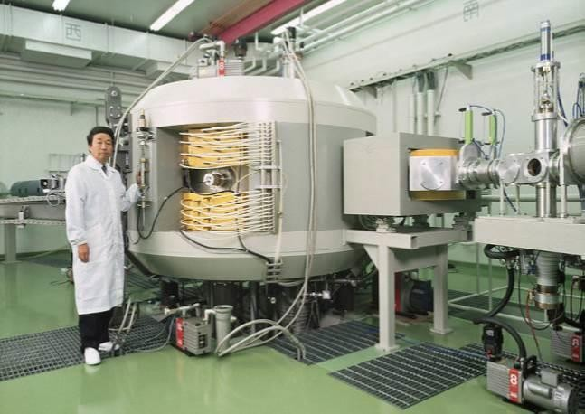
ACCELERATORS FOR RADIONUCLIDE PRODUCTION
They are smaller than the ones used for particle physics experiments.
They need to accelerate particles to relatively low energies for radioisotope production.
Adapted from: Nuclear Medicine Physics:
A Handbook for Teachers and Students

Slide 23
CHARACTERISTICS OF ACCELERATORS FOR RADIONUCLIDE PRODUCTION
Proton energy (MeV) | Accelerated particles | Used for
<10 | Mainly single particle, p or d | PET
10–20 | Usually p and d | PET
30–40 | p and d, ³He and ⁴He may be available | PET, commercial production
40–500 | Usually p only | Often placed in national centres and have several users
Adapted from: Nuclear Medicine Physics:
A Handbook for Teachers and Students

Slide 24

RADIONUCLIDE GENERATORS
Whenever a radionuclide (parent) decays to another radioactive nuclide (daughter), this is called a radionuclide generator.
T1 /2 parent)>>>>T1/2(daugter)
A
Chemical features of A y B: diferent
B should easily separated from A
B- Apropiate anergy and physical properties for diagnosis and/or therapy
Parent T_{1/2}
B
DaugterT_{1/2}

Slide 25
GENERATORS USED IN NUCLEAR MEDICINE
Several radionuclides used in nuclear medicine are produced by generator systems such as the ⁹⁹Mo production of ^{99m}Tc, which subsequently decays to ⁹⁹Tc.
The half-life of the parent (2.7 d) is adequate for transport and delivery, and the daughter has a suitable half-life (6 h) for patient investigations.
Adapted from: Nuclear Medicine Physics:
A Handbook for Teachers and Students

Slide 26
SEPARATION OF THE GENERATOR
RADIONUCLIDES
Most generators in nuclear medicine use ion exchange columns due to its simplicity of handling.
In the ⁹⁹Mo/^{99m}Tc generator, ⁹⁹Mo is adsorbed onto alumina.
Eluting the immobilized ⁹⁹Mo on the column with physiological saline elutes the soluble ^{99m}Tc in a few millilitres of liquid.
Adapted from: Nuclear Medicine Physics:
A Handbook for Teachers and Students

Slide 27
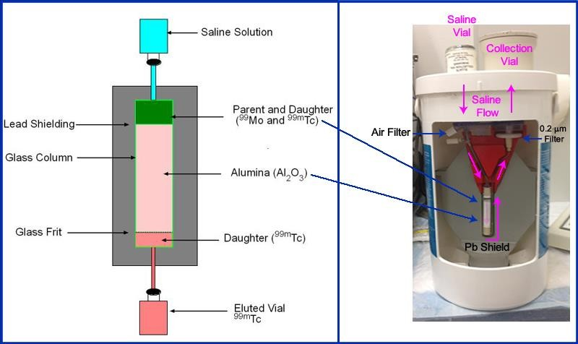
GENERATORS USED IN NUCLEAR MEDICINE
Adapted from: Nuclear Medicine Physics:
A Handbook for Teachers and Students

Slide 28
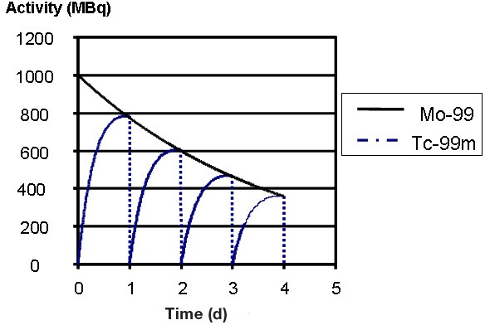
ELUTION OF A 99MO/99MTC GENERATOR
Tc is eluted daily, rising again the activity between elutions due to the Mo-Tc reaction.
Adapted from: Nuclear Medicine Physics:
A Handbook for Teachers and Students

Slide 29
GENERATORS OF INTEREST IN NUCLEAR MEDICINE
Generators
99Mo-99mTc
68Ge-68Ga
90Sr-90Y
81Rb-81mKr
82Sr-82Rb
225Ac-213Bi
Usage
General Nuclear Medicine
Peptide labelling
β therapy
Ventilation studies
Cardiac PET
α therapy
Adapted from: Nuclear Medicine Physics: A Handbook for
Teachers and Students

Slide 30
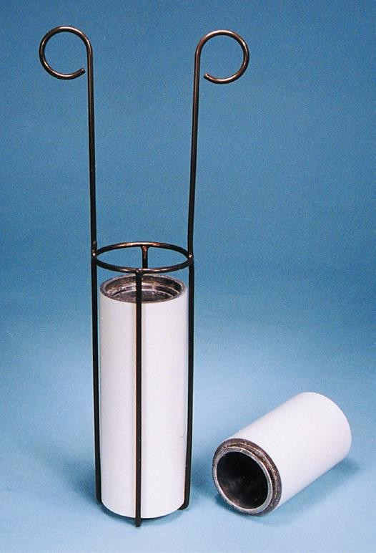
GENERATOR ELUTIONS RECORDS
The following records should be kept for all
generator elutions:
Time of elution
Volume of eluate
Technetium-99m activity
Molybdenum-99 activity
Radionuclidic purity
Moly assay shield
Adapted from: Nuclear Medicine Physics: A Handbook for
Teachers and Students

Slide 31
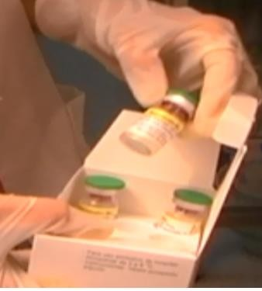
RADIOPHARMACEUTICAL PREPARATIONS RECORDS
Records of each preparation should include the:
Name of the radiopharmaceutical
Cold kit batch number
Date of manufacture
Batch number of final product
Radiochemical purity results
Expiry date
Registering cold kit data
Adapted from: Nuclear Medicine Physics: A Handbook for
Teachers and Students

Slide 32
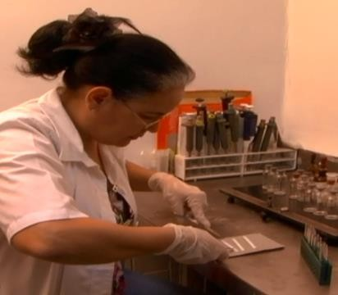
QC OF TC RADIOPHARMACEUTICALS
99mTc radiopharmaceuticals require
a two strip testing procedure.
At least three radiochemical species are typically present:
The primary 99mTc
radiopharmaceutical;
Free pertechnetate or 99mTcO4
Hydrolysed reduced and insoluble 99mTcO2.
Adapted from: Nuclear Medicine Physics: A Handbook for
Teachers and Students

Slide 33
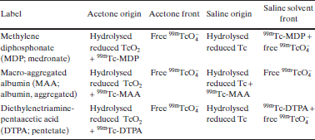
EXAMPLES OF ITLC SEPARATION OF RADIOCHEMICAL SPECIES FOR 99mTc RADIOPHARMACEUTICALS USING ACETONE
(ORGANIC) AND SALINE (AQUEOUS) SOLVENTS
TRS 454, IAEA, 2006

Slide 34
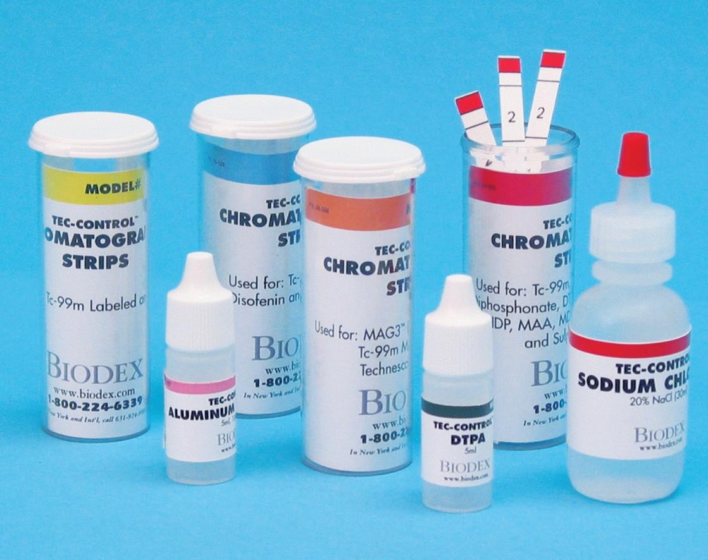
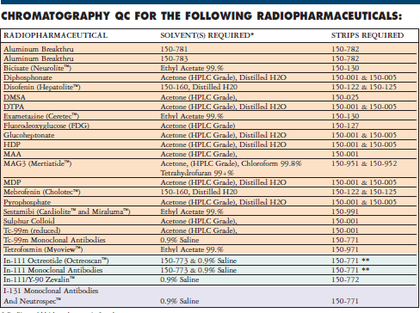
RADIOPHARMACEUTICALS QC KITS
Adapted from: Nuclear Medicine Physics: A Handbook for
Teachers and Students

Slide 35
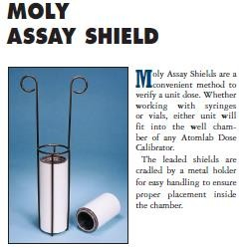
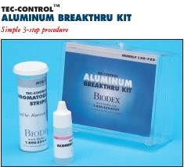
KITS AND ACCESSORIES FOR MO AND AL
DETEMINATIONS
Adapted from: Nuclear Medicine Physics: A Handbook for
Teachers and Students

Slide 36
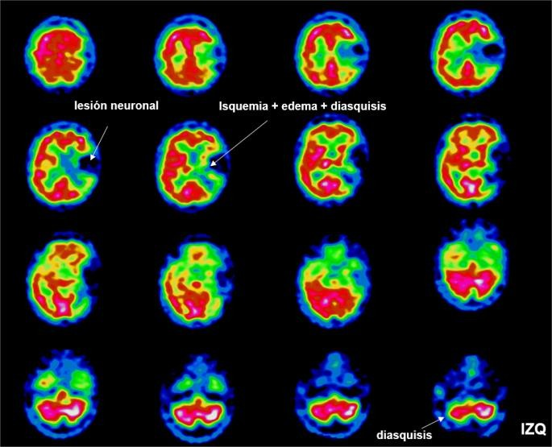
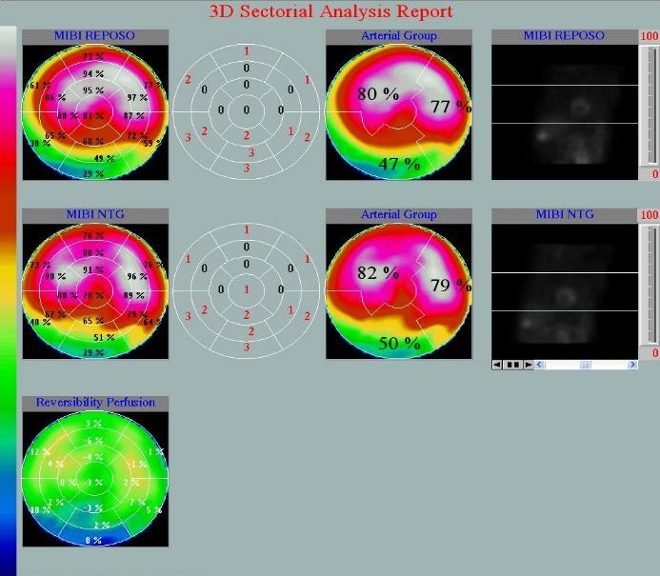
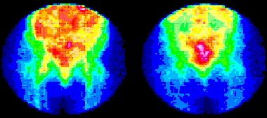

RADIOPHARMACEUTICALS
First Generation (1950-1960): Inorganic radionuclides (eg.NaI)
Second generation: Radionuclide inside an organic molecule (99mTc-MAA, 113mIn-MAFe(OH)3 y
113mIn-Coloidal, etc)
Third Generation: Structural unit between carrier and radionuclide (e,g. 99mTc MIBI, 99mTc-HMPAO)
Fourth Generation: Labeled biomolecules (e.g. 99mTc-Nimotuzomab)
99mTc-HMPAO
e,g. 99mTc MIBI
99mTc-Nimotuzomab

Slide 37
THANK YOU

