Slide 1
MODULE: AGRICULTURE EXTENSION
ASSIGNMENTS OF TECHNOLOGY TRANSFER SKILLS AND STRATEGIES
Topic: how extension education deviates from formal system?”
Lecturer: Dr. HABIMANA Sylvestre

Slide 2

Presented by group 1
Names | Registration No | Department
KAYUMBA Johnson |  | Horticulture
KWIZERA Emmanuel |  | Horticulture
MUKASINE Adele |  | Horticulture
NKURUNZIZA Jean Pierre | 217018378 | Horticulture
UKWIBISHAKA Nepomuscene | 217078125 | Horticulture

Slide 3
Meaning of education
Education is a process of giving training and instruction to people to develop their abilities, skills, behaviors, and characters.
Skills; ability to do things
Knowledge includes facts, concepts, principles and relationship
Wisdom the body of knowledge and experience that develops within specified society or period
Attitude a settled way of thinking or feeling about something.

Slide 4
Informal Education
Formal Education
Non-formal Education

Slide 5
Informal Education is the lifelong process by which every person acquires and accumulates knowledge, skill, attitude and insights from daily experiences.
Example: Reading books, newspaper, listening to the radio etc.

Slide 6
Formal Education is the highly institutionalized, chronologically graded and hierarchically structured education system spanning lower primary school and upper reaches of the university. involving graduation, and awarding of some kinds of certificates (diploma and degrees) before entering the workforce.
Example: School Education
Characteristics
Formal education is structured hierarchically
It is planned and deliberate
Scheduled fees are paid regularly
It has chronological grading

Slide 7
Non-formal Education is an organized, systematic, educational activity carried on outside the frame work of the formal system to provide selected types of learning to particular subgroups in the population, adults and children according to their needs. Here we can say; adult education, Extension Education
Characteristics
is planned and takes place apart from the school
timetable and syllabus can be adjustable
it is practical and vocational education.

Slide 8

Extension Education
extension education is a science which deals with the creation, transmission and application of knowledge designed to bring about planned changes in the behavior (knowledge, skill and attitude) of people; with a view to help them live better by learning the ways of improving their vocations, enterprise and institutions.

Slide 9

Objectives
To establish and transferring skills and knowledge from researchers to educated and non-educated people
Advising people in their decision making, educating them and being able to make a similar decision in future.

Slide 10
THE DIFFERENCE BETWEEN FORMAL EDUCATION AND EXTENSION EDUCATION
Formal Education
The teacher starts with theory of the Extension education starts with practical.
The learners are homogenous with the Common goals.
Teaching is largely confined to the premises of the institutions.
The learners adapt to the fixed curriculum offered by the institutions.
Strict adherence to institutional rules subject and regulations.
The teacher only instructs the students Leaders\ progress farmers.
Knowledge flows from the teacher to the learners.
It is more theoretical oriented.
It is more rigid in nature

Slide 11
Extension Education
Subject and works up to practical problem of the learners and may take up theory later on.
Learners (adults) are heterogeneous and have diverse goals.
Extension teaching is mostly outside the four walls of the formal institution.
Extension education has no fixed curriculum. It has to be designed as per the requirements of farmers.
Freedom of attendance and choice of matters are left to the learners.
the extension agents/workers teach a great deal through locally
Knowledge flows from both teacher to learners and from learners to teacher.
It is more practical and problem solving
It is flexible in nature

Slide 12
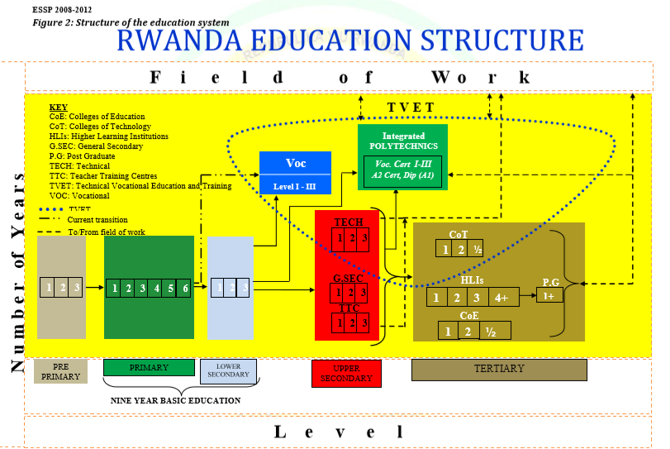

Slide 13
Principles of Extension of Education
Principle of interests and needs
Principle of existing environment
Principle of Participation and co-operation
Principle of learning by doing
Principle of satisfaction-
Principle of leadership
Principle of grass roots approach
Principle of democratic approach
Principle of culture difference
Principle of indigenous knowledge

Slide 14

Process of extension education
Based on Leagans (1961) extension educational process involves five essential and integrated steps.
TEACHING (What to teach and how to teach)
EVALUATION (What has been the result)
RECONSIDERATION (What next to do)
SITUATION (What it is now)
OBJECTIVES-goals (What should be)

Slide 15

conclusion
Therefore, education is usually referring to formal education institutions delivering a planned curriculum leading to a degree or diploma before entering the workforce whereas extension is usually referring to planned educational programs designed to meet the needs of people in the workforce.

Slide 16
REFERENCES
Adivi reddy. A, Extension education, seventh edition, Sri Lakshmi press, bapatla
Etling, A. (1993). What is nonformal education? Journal of agriculture education, 34(4)
Dahama, O.P., Bhatanagar,O.P. 1985. Education and Communication for Development, Oxford & IBH Publishing Company, New Delhi,
Ensminger, Douglas (1957), A guide to Community Development, Ministry of Community Development, Government of India, Coronation Printing Works, Fatehpuri, Delhi-6.
Supe S.V. (1987), an Introduction to Extension Education, Oxford and IBH Publishing Co. Pvt. Ltd. New Delhi

